Slide 1
Introduction To C#
Hello World!

Slide 2
Overview
What is .NET?
What is the FCL?
What is the CLR?
Building Hello, World!
Basic expressions and operators
Compilers and command line tools
Creating projects with Visual Studio

Slide 3

.NET
A software framework
http://msdn.microsoft.com/en-us/netframework/default.aspx
Your Application
Common
Language
Runtime
(CLR)
Framework
Class
Library
(FCL)

Slide 4




CLR
The CLR manages your application when it runs
Memory management
Security
Operating system and hardware independence
Language independence
Common
Language
Runtime
(CLR)

Slide 5


FCL
Framework class library
A library of functionality to build applications
Framework
Class
Library
(FCL)

Slide 6
What is C#?
A standardized language to create .NET components
Standardized by ECMA
Create applications, services, and reusable libraries
Syntax is similar to Java and C++
public static void Main()
{
if (DateTime.Now.DayOfWeek == DayOfWeek.Monday)
{
Console.WriteLine("Another case of the Mondays!");
}
}

Slide 7
csc.exe
The C# command line compiler
Transforms C# code into Microsoft Intermediate Language
Produces an assembly (.dll, .exe)
csc.exe
file.cs
file.cs
myapp.exe
file.cs
file.cs

Slide 8
.NET Today
.NET
FRAMEWORK
.NET
CORE
XAMARIN
WINDOWS
APPS
X-PLAT
APPS & SERVICES
MOBILE
APPS

Slide 9






.NET Core
Fast
Cross-platform
Lightweight
Open Source
Compatible
Tools

Slide 10
.NET Runtime
CoreCLR
GC
CoreFX
System.IO
System.XML
CLI
Build
Run Tests
String
Collections
System.NET
Crypto
Threading
CodeDOM
Reflection
Run
Create
JIT

Slide 11
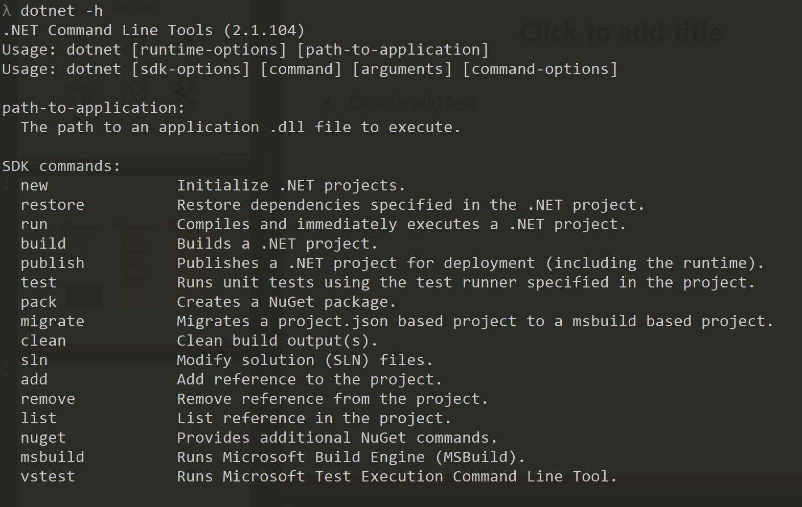
dotnet CLI

Slide 12
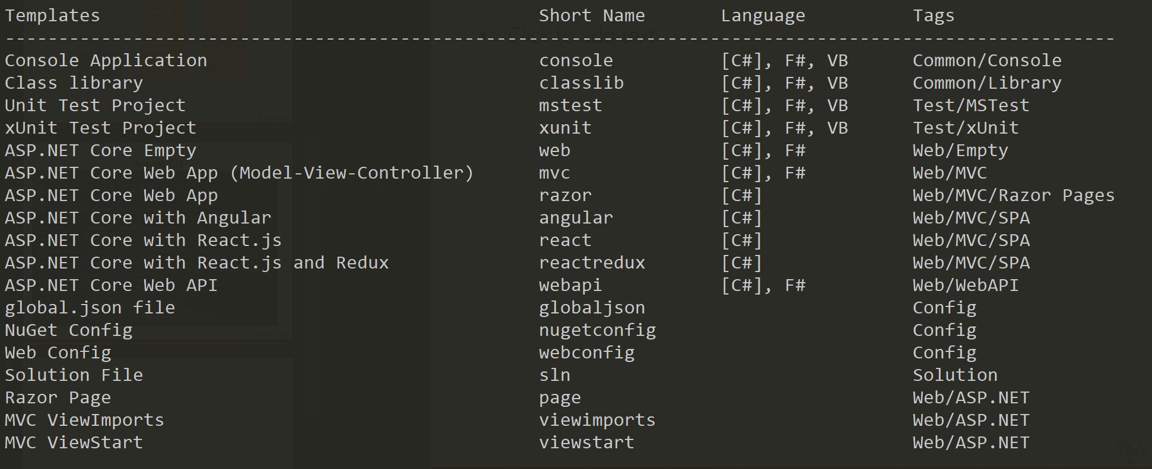
dotnet new

Slide 13
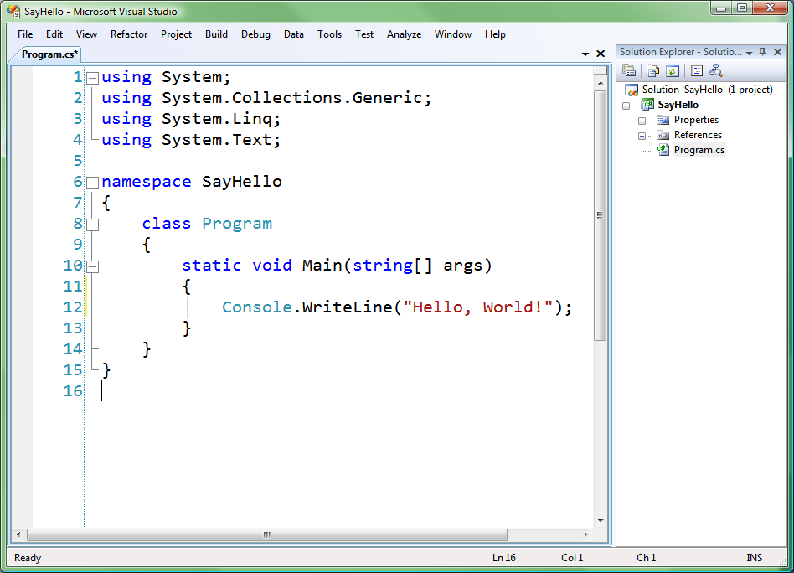
Visual Studio
An integrated development environment
Edit C# (and other) files
Runs the C# compiler
Debugging
Testing

Slide 14
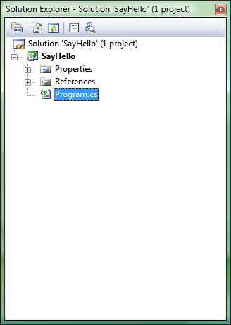
Solution Explorer
Will contain at least one project
Contains one or more source code files
Each project produces an assembly
Projects organized under a solution
Manage multiple applications or libraries

Slide 15
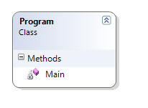
Types
C# is strongly typed
One way to define a type is to write a class
Every object you work with has a specific type
1,000s of types are built into the .NET framework
You can define your own custom types
Code you want to execute must live inside a type
You can place the code inside a method
We’ll explore other things you can add to a type later …

Slide 16
Primitive Types
Name | Description
Int32 (or int) | 32 bit integer
Int64 (or long) | 64 bit integer
Boolean (or bool) | true or false
Float (or float) | Single precision floating point
Double (or double) | Double precision floating point
Decimal (or decimal) | Fixed precision (financial)
DateTime | An instant in time (to 100 ns)
String (or string) | Text (as Unicode characters)

Slide 17
Namespaces
Namespace organize types
Avoid type name collisions
Can define namespace in one or more places
Fully qualified type names
Includes the assembly name
Includes the namespace
Includes the type name
using Directive
Brings other namespaces into scope
No need to namespace qualify a Type
using System;
using System.Net;
using System.Data;
using System.Linq;
using System.Text;

Slide 18
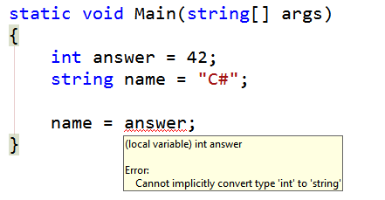
Variables
Variables hold a value
Variables always have a type
Must assign a value before you can use a variable
C# compiler will make sure types are compatible during assignment

Slide 19
Statements & Expressions
A statement is an instruction
A method is a series of statements
Statements end with semicolons
Statements are executed in the order they appear
Expressions are statements that produce a value
Typically involve an operator (not required)
Can assign the expression value to a new variable, or test it
TakeOrder();
PackageOrder();
ShipOrder();
int x = 5;
int y = 10;
int answer = x + y;

Slide 20
Operators
Specify an operation to perform on one or more variables
Mathematical operators ( + , - , * , / )
Relational operators ( < , > , <= , >= )
Equality operators (==, !=)
Conditional operators (&&, ||)
Assignment operators (=, +=, -=, *=, /=)
int x = 5;
int y = 10;
if (x != y)
{
x++;
}
else
{
y += x;
}

Slide 21
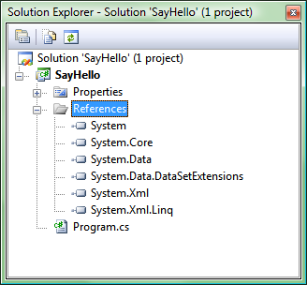
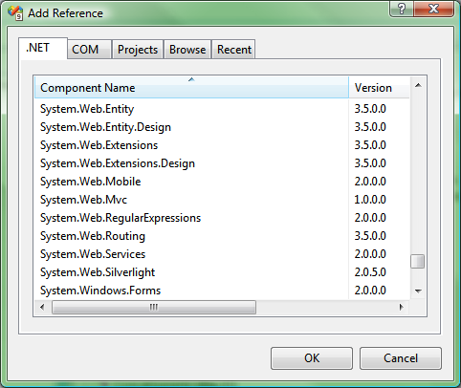
References
Allow you to use types in another assembly
Object Browser is one way to examine types
Reference other assemblies in the FCL
Reference 3rd party assemblies
Reference other assemblies in solution

Slide 22
Summary
C# is one of the many languages for .NET
Syntax similar to C++ and Java
Strongly typed
Statements and expressions
Operators
References

